Slide 1
Richland Stakeholder Results
Cory Poris Plasch
Rapp Consulting Group
January 3, 2023

Slide 2
Cory’s Background
10 yrs. in local government, 6 as a 911 Dispatcher
4 yrs. VP at a mission-driven tech start up (Polco/National Research Center)
Leadership roles in the Alliance for Innovation and the Wisconsin City/County Management Association
Presents at conferences nationally on innovation, use of data, and engaging hard to reach populations

Slide 3

Internal Stakeholder Survey Results

Slide 4
Survey Respondents:
Notes:
45% response rate, 267/591

Slide 6
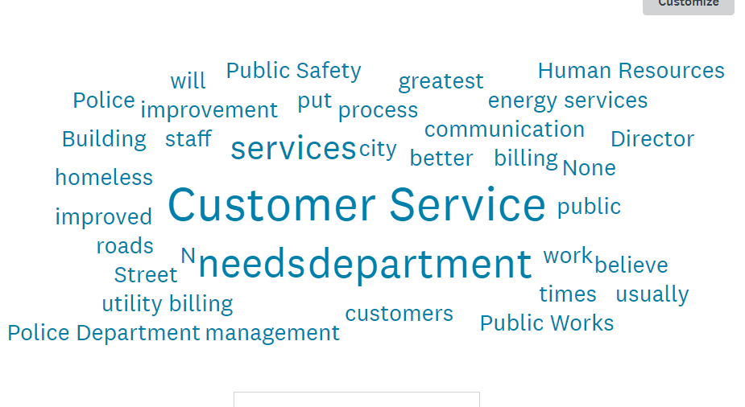
What city service(s), if any, do you believe needs improvement?
Notes:
Customer service is split into several areas: utility billing, interactions between departments, and general interactions with the public. Additionally, more staff in the police department came up several times. Utilities and utility billing, public works (specifically snow removal) and infrastructure.

Slide 8
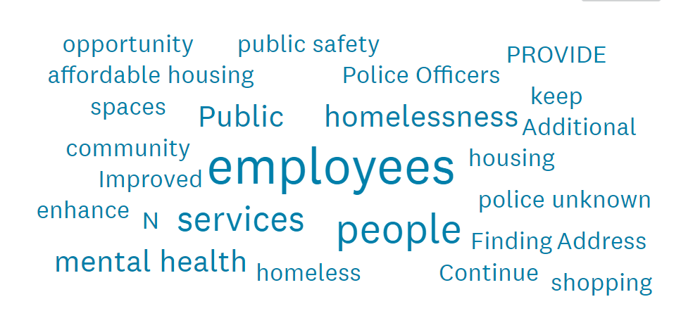
What one improvement, if any, could have the greatest positive impact on quality of life in Richland?
Notes:
Public safety; general staffing (more staff, COLA, etc), mental health, affordable housing, homelessness

Slide 13
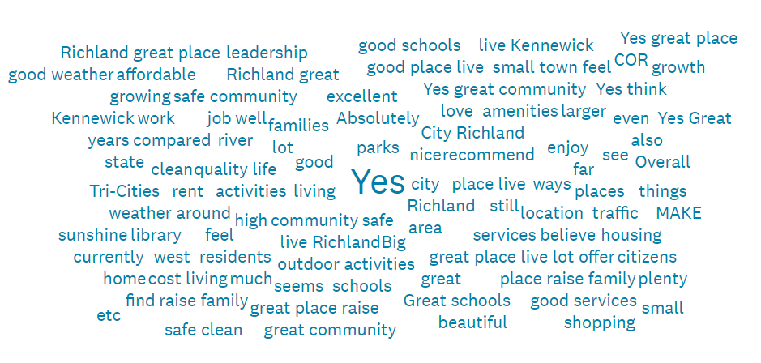
Would you recommend the City of Richland as a place to live? Why or why not?
Notes:
13 said no, 16 neutral, 187 yes

Slide 14
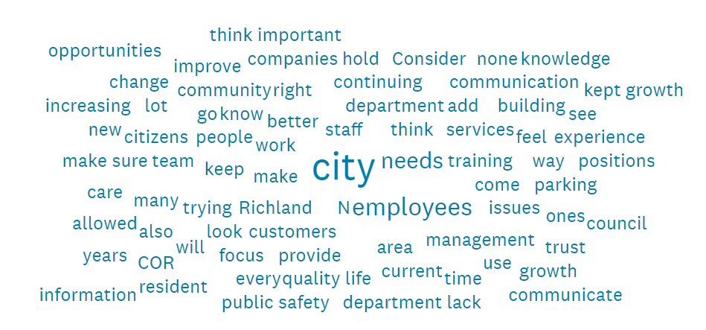
Please add any additional information you think would help to inform the strategic planning process at Richland
Notes:
Staffing issues noted that are more appropriate for internal use. Otherwise, results similar to focus groups

Slide 15

Questions?

Slide 16
Thank you!
Cory Poris Plasch
Rapp Consulting Group

